Slide 1

Advanced Topics in Economic Evaluation and Healthcare
Lecture #4: Markov Models

Slide 2
Lecture Overview
In this lecture we will introduce Markov models. We will cover:
  A Conceptual Overview of Markov Models.
  Technical Aspects of Markov Models and Computing.
  Simulating Markov Processes.
  Doing Economic Evaluation with Markov Models.
  A computational example of Markov Models in Economic Evaluation.

Slide 3
A Conceptual Overview of Markov Models in Economic Evaluation

Slide 4
An Introduction to Markov Models
Depending on the nature of an intervention a decision tree can become quite complex and it quickly becomes difficult to work with.
Further a decision tree may not be the best way to represent a disease which has repeated events.
As an example: Consider the case of a patient with ulcerative colitis.
Ulcerative colitis is a chronic inflammatory bowel disease that causes long-lasting inflammation and ulcers in the innermost lining of the large intestine and rectum.
Patients Exist in one of two states at
  Active Disease- which involves frequent urgent diarrhea, abdominal pain, rectal bleeding, and fatigue.
  Remission- A state when no symptoms are being experienced.
Throughout a patient’s life they will find themselves in one of these two states.

Slide 5




Graphically Representing A Markov Model
We can graphically represent this process in the below diagram.
$$P(AD|R)$$
$$P(R|R)$$
Active
Disease
Remission
$$P(AD|AD)$$
$$P(R|AD)$$

Slide 6
Graphically Representing A Markov Model
We can graphically represent this process in the below diagram.
These are the health states
$$P(AD|R)$$
$$P(R|R)$$
Active
Disease
Remission
$$P(AD|AD)$$
$$P(R|AD)$$

Slide 7


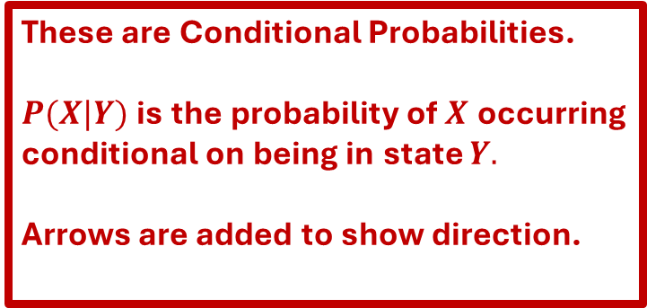


Graphically Representing A Markov Model
These are Conditional Probabilities.
$P(X|Y)$ is the probability of $X$ occurring
conditional on being in state $Y.$
Arrows are added to show direction.
We can graphically represent this process in the below diagram.
$$P(AD|R)$$
$$P(R|R)$$
Active
Disease
Remission
$$P(AD|AD)$$
$$P(R|AD)$$

Slide 8
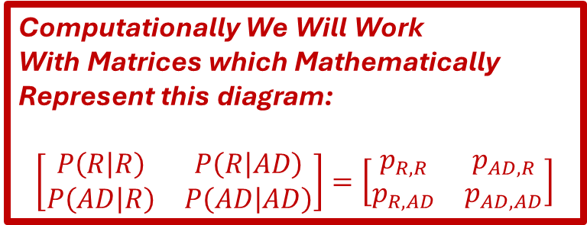
Graphically Representing A Markov Model
Computationally We Will Work
With Matrices which Mathematically
Represent this diagram:
$$\left[\begin{matrix}P\left(R | R\right) & P\left(R | AD\right) \\ P\left(AD | R\right) & P\left(AD | AD\right)\end{matrix}\right]=\left[\begin{matrix}p_{R,R} & p_{AD,R} \\ p_{R,AD} & p_{AD,AD}\end{matrix}\right]$$
We can graphically represent this process in the below diagram.
$$P(AD|R)$$
$$P(R|R)$$
Active
Disease
Remission
$$P(AD|AD)$$
$$P(R|AD)$$

Slide 9
The Idea of Markov Cost Effectiveness Models
When we are doing a cost effectiveness analysis with a Markov model, we are choosing between two distinct process. We will need to compute costs and effects.
New Treatment
AD
R
AD
R
Base Treatment

Slide 10
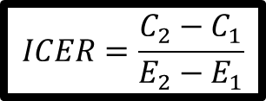
The Idea of Markov Cost Effectiveness Models
When we are doing a cost effectiveness analysis with a Markov model, we are choosing between two distinct process. We will need to compute costs and effects. (WE WILL STILL COMPUTE AN ICER).
Effects
New Treatment
AD
R
Costs
$$ICER=\frac{C_{2}−C_{1}}{E_{2}−E_{1}}$$
Effects
AD
R
Base Treatment
Costs

Slide 11
Technical Aspects of Markov Models and Computing

Slide 12
Properties of Markov Models
When computing Markov models we will always work with Square Matrices.
  A matrix is a rectangular array of numbers.
  Square means that there are the same number of rows as there are columns.
  The dimensions of a Markov matrix correspond to the number of health states we are considering. (i.e. if there are 2 health states we need a 2x2 matrix, 3 health states 3x3 etc.)
The Matrices we work with possess the Markov Property- The probability of moving to a different state depends only on the current state.
  Ex: in the case of the example with ulcerative colitis, in the context of the model, past active disease states do not impact future disease states.
We also require that each row’s entries sum to 1

Slide 13

Understanding Markov Matrices: An Example
Suppose we have the following Matrix:
$$\left[\begin{matrix}0.7 & 0.2 & 0.1 \\ 0 & 0.9 & 0.1 \\ 0 & 0 & 1\end{matrix}\right]$$
Question #1: Do the elements of each row sum to 1?
Question #2: What is the graphic representation of this matrix?

Slide 14

Understanding Markov Matrices: An Example
Suppose we have the following Matrix:
$$\left[\begin{matrix}0.7 & 0.2 & 0.1 \\ 0 & 0.9 & 0.1 \\ 0 & 0 & 1\end{matrix}\right]$$
Question #1: Do the elements of each row sum to 1? YES
Question #2: What is the graphic representation of this matrix? (SEE THE NEXT SLIDE)

Slide 15

Understanding Markov Matrices: An Example
$\left[\begin{matrix}0.7 & 0.2 & 0.1 \\ 0 & 0.9 & 0.1 \\ 0 & 0 & 1\end{matrix}\right]$
Graphically we can represent this matrix as as:
Note: In this context the State 3 is called the ABSORBING STATE as it is the state where all individuals will end up if the model is simulated long enough.
0.9
State 2
0.7
0.2
0.1
1
State 1
State 3
0.1

Slide 16
Simulating Markov Processes

Slide 17
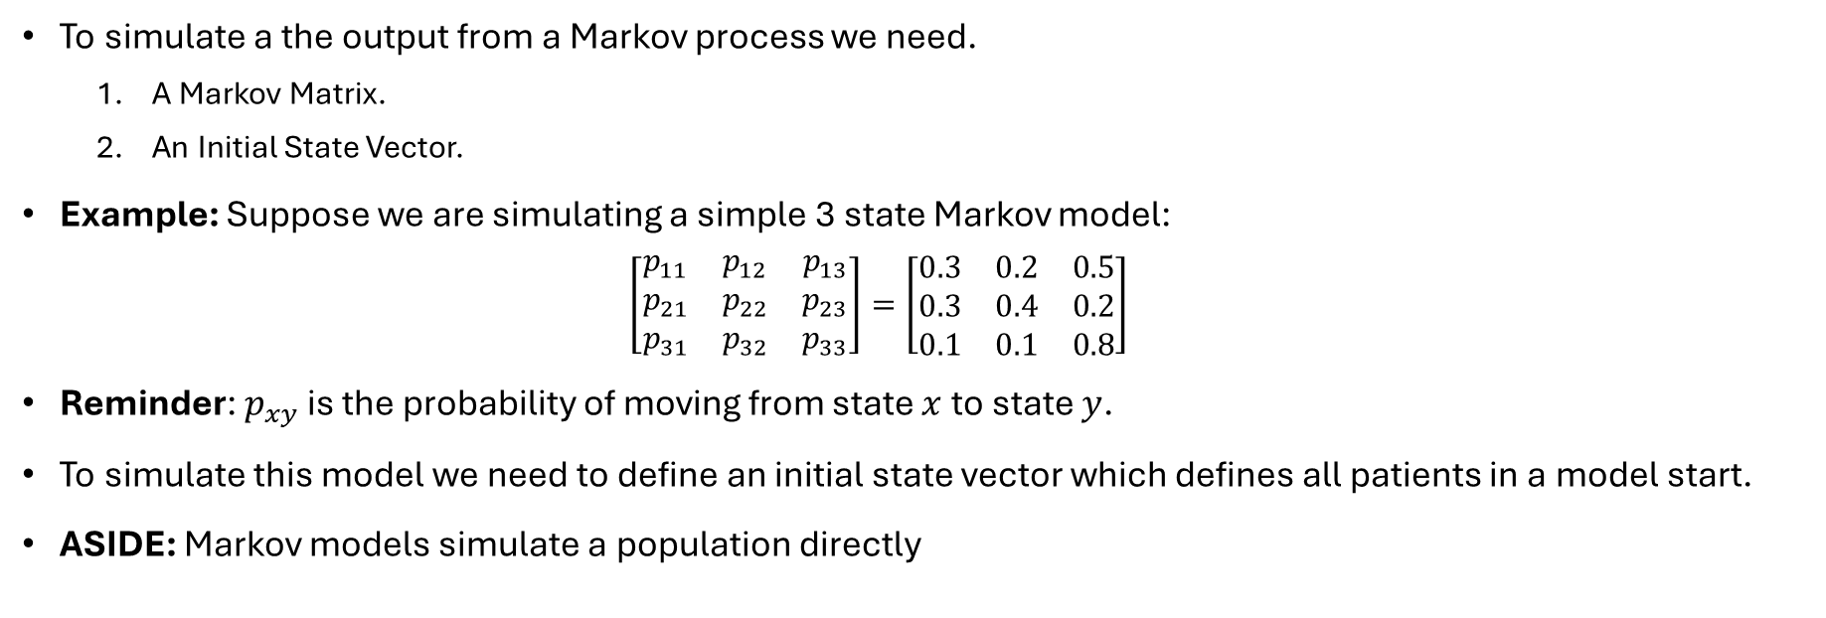
How do we simulate a Markov Model?
To simulate a the output from a Markov process we need.
  A Markov Matrix.
  An Initial State Vector.
Example: Suppose we are simulating a simple 3 state Markov model:
  $$\left[\begin{matrix}p_{11} & p_{12} & p_{13} \\ p_{21} & p_{22} & p_{23} \\ p_{31} & p_{32} & p_{33}\end{matrix}\right]=\left[\begin{matrix}0.3 & 0.2 & 0.5 \\ 0.3 & 0.4 & 0.2 \\ 0.1 & 0.1 & 0.8\end{matrix}\right]$$
Reminder: $p_{xy}$ is the probability of moving from state $x$ to state $y$.
To simulate this model we need to define an initial state vector which defines all patients in a model start.
ASIDE: Markov models simulate a population directly

Slide 18
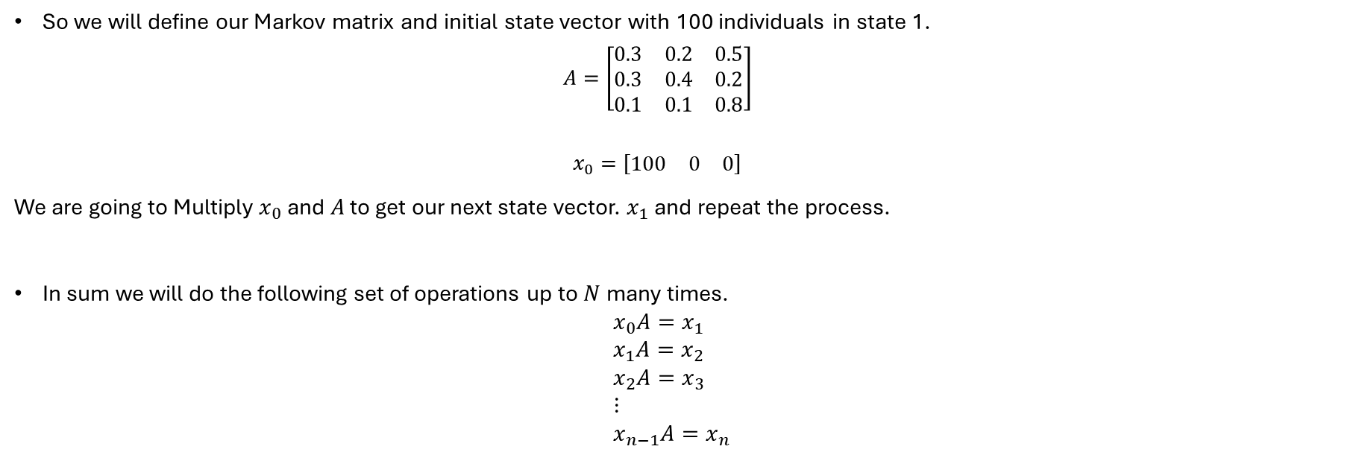
How do we simulate a Markov Model?
So we will define our Markov matrix and initial state vector with 100 individuals in state 1.
  $$A=\left[\begin{matrix}0.3 & 0.2 & 0.5 \\ 0.3 & 0.4 & 0.2 \\ 0.1 & 0.1 & 0.8\end{matrix}\right]$$
  $$x_{0}=[\begin{matrix}100 & 0 & 0\end{matrix}]$$
We are going to Multiply $x_{0}$ and $A$ to get our next state vector. $x_{1}$ and repeat the process.
In sum we will do the following set of operations up to $N$ many times.
$x_{0}A=x_{1}$
$x_{1}A=x_{2}$
$x_{2}A=x_{3}$
$⋮$
$x_{n−1}A=x_{n}$
If you are curious about the math behind this, this is just standard matrix multiplication. I will not
review this technically as we will be using software to do the “heavy computational lifting” for us.

Slide 19
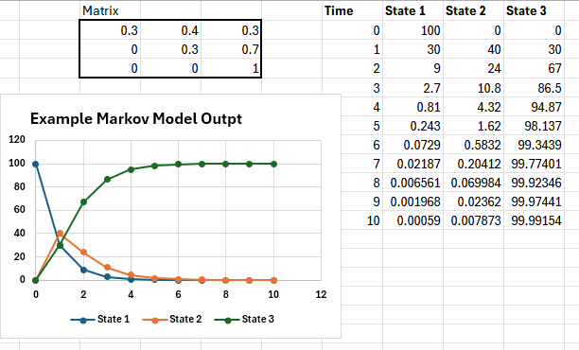
Simulating A Markov Process in Excel
While there are many softwares to simulate Markov processes, one of the simplest ways to do this is in excel.
We will use the =MMULT() Command to do the heavy lifting for us.
In general we will have =MMULT(`State Vector`, `Markov Matrix`) as the main command.
By the end of this exercise, we should have a picture as the below:

Slide 20
Excel Exercise

Slide 21
Doing Economic Evaluation With Markov Models

Slide 22
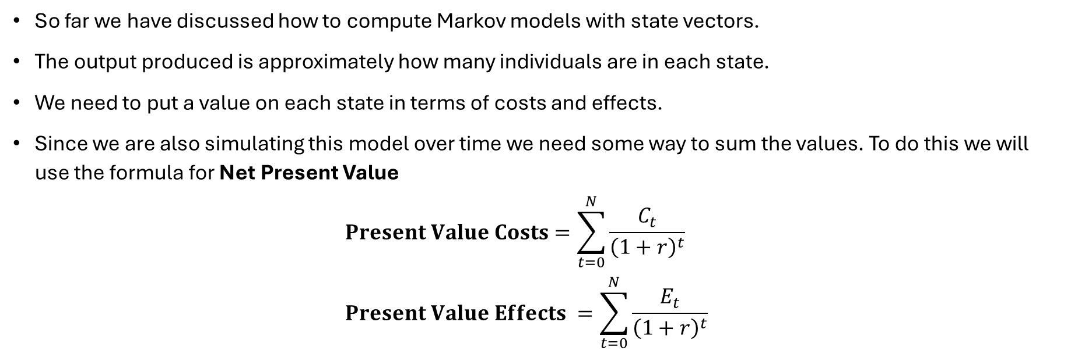
What we need
So far we have discussed how to compute Markov models with state vectors.
The output produced is approximately how many individuals are in each state.
We need to put a value on each state in terms of costs and effects.
Since we are also simulating this model over time we need some way to sum the values. To do this we will use the formula for Net Present Value
$Present Value Costs=\sum_{t=0}^{N}{\frac{C_{t}}{{\left(1+r\right)}^{t}}}$
$Present Value Effects =\sum_{t=0}^{N}{\frac{E_{t}}{{\left(1+r\right)}^{t}}}$

Slide 23
The Idea of Markov Cost Effectiveness Models
Recall, to do a cost effectiveness analysis model we need to (1) generate costs and effects for a base treatment (2) … for a New Treatment of Interest (3) Compute the ICER.
Effects
New Treatment
AD
R
Costs
$$ICER=\frac{C_{2}−C_{1}}{E_{2}−E_{1}}$$
Effects
AD
R
Base Treatment
Costs

Slide 24
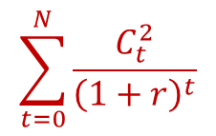
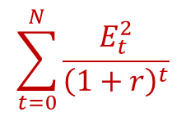
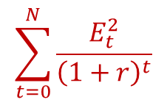
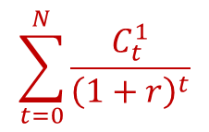

The Idea of Markov Cost Effectiveness Models
Recall, to do a cost effectiveness analysis model we need to (1) generate costs and effects for a base treatment (2) … for a New Treatment of Interest (3) Compute the ICER.
$$\sum_{t=0}^{N}{\frac{E_{t}^{2}}{{\left(1+r\right)}^{t}}}$$
New Treatment
AD
R
$$\sum_{t=0}^{N}{\frac{C_{t}^{2}}{{\left(1+r\right)}^{t}}}$$
$$ICER=\frac{PVC_{2}−PVC_{1}}{ PVE_{2}−PVE_{1}}$$
$$\sum_{t=0}^{N}{\frac{E_{t}^{2}}{{\left(1+r\right)}^{t}}}$$
AD
R
Base Treatment
$$\sum_{t=0}^{N}{\frac{C_{t}^{1}}{{\left(1+r\right)}^{t}}}$$

Slide 25

Economic Evaluation Concerns: Discounting
The way costs and effects are discounted are done so in a uniform manner.
There will be a whole class on this topic.
For now the discount rate choice should follow country specific guidelines.
In Canada by the Canadian Drug Agency (CDA) a discount rate of 1.5% is
recommended for both costs and effects.

Slide 26
Computing a Markov Model for Cost Effectiveness Analysis

Slide 27

Example of A Markov Model: An Example with Ulcerative Colitis
We finally have all the tools we need for implementing a Markov Model for cost effectiveness analysis.
Suppose we are analyzing the cost-effectiveness of a new biologic drug compared to the baseline treatment of mesalamine.

Slide 28
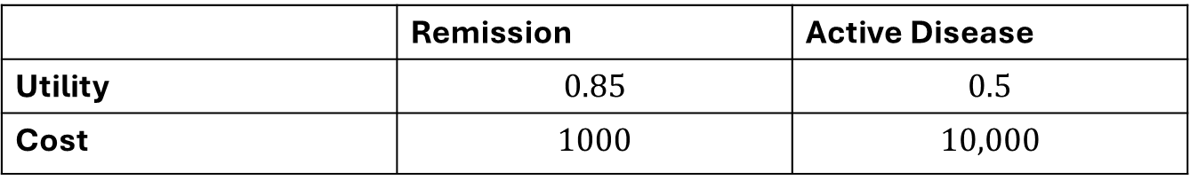
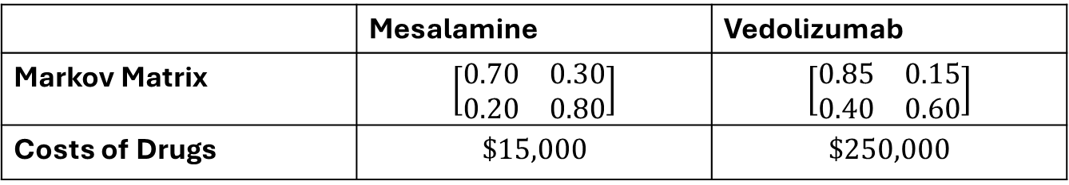
Example of A Markov Model: An Example with Ulcerative Colitis
We have the Following Fictitious Data:
Intervention Level Data
 | Mesalamine | Vedolizumab
Markov Matrix | $$\left[\begin{matrix}0.70 & 0.30 \\ 0.20 & 0.80\end{matrix}\right]$$ | $$\left[\begin{matrix}0.85 & 0.15 \\ 0.40 & 0.60\end{matrix}\right]$$
Costs of Drugs | $$\$15,000$$ | $$\$250,000$$
Discount Rate
Follows CDA Guidelines
at 1.5%
Simulate Model for
10 Years (10 Periods)
Start with 100 patients in Remission for both Drugs.
State Level Data
 | Remission | Active Disease
Utility | $$0.85$$ | $$0.5$$
Cost | $$1000$$ | $$10,000$$

Slide 29
Example of A Markov Model: An Example with Ulcerative Colitis
Let us Build this model out in Excel!

Slide 30
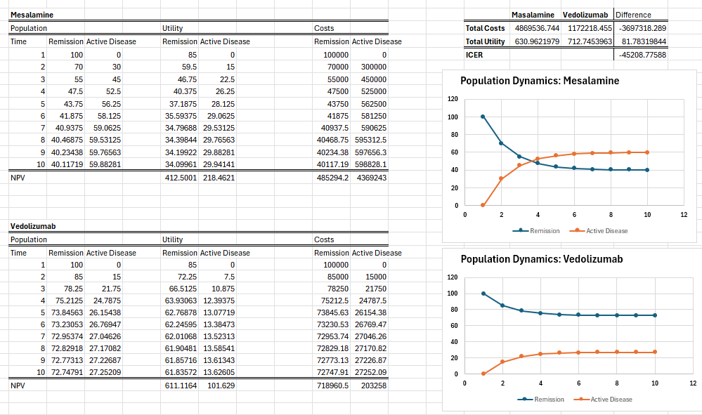
The Expected Model Output

Slide 31
The Expected Model Output
This is a Negative ICER.
BE CAREFUL!
Here we see Vedolizumab is Cost Saving But that’s only from looking at both changes in costs and effects individually.

Slide 32
Calibration Issues

Slide 33
Calibrating the Markov Transition Matrix
We have seen that Markov models are powerful tool for representing complex disesase processes over time where events repeat.
Often however we will have risks– that is the probability of moving from one state to another at different levels.
  Some will be reported annually.
  Some will be reported quarterly.
  Some are every six months.
If our time increment is smaller than this, the transition probabilities do not represent process accurately.
We also must contend with the following fact:
PROBABILITIES MAY NEVER BE DIVIDED OR SCALED OVER TIME.

Slide 34
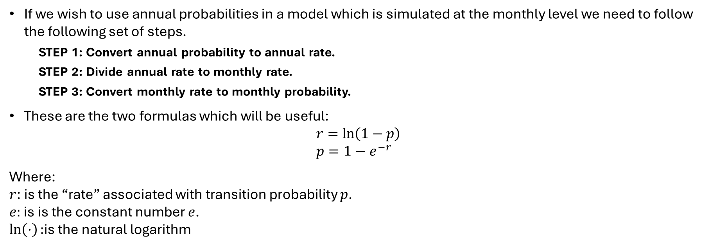
Properly Calibrating Probabilities.
If we wish to use annual probabilities in a model which is simulated at the monthly level we need to follow the following set of steps.
  STEP 1: Convert annual probability to annual rate.
  STEP 2: Divide annual rate to monthly rate.
  STEP 3: Convert monthly rate to monthly probability.
These are the two formulas which will be useful:
$r=\ln\left(1−p\right)$
$p=1−e^{−r}$
Where:
$r$: is the “rate” associated with transition probability $p$.
$e:$ is is the constant number $e$.
$\ln\left(⋅\right):$is the natural logarithm

Slide 35
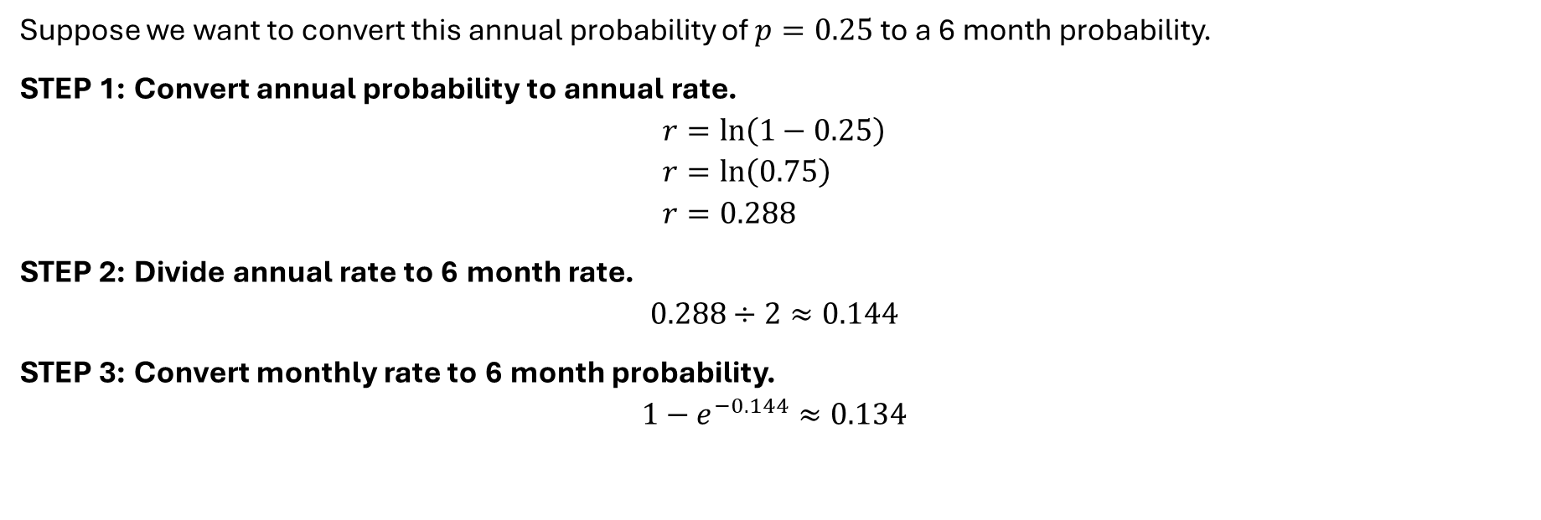
Properly Calibrating Probabilities: An Example
Suppose we want to convert this annual probability of $p=0.25$ to a 6 month probability.
STEP 1: Convert annual probability to annual rate.
$$r=\ln\left(1−0.25\right) \\ r=\ln\left(0.75\right) \\ r=0.288$$
STEP 2: Divide annual rate to 6 month rate.
$$0.288÷2≈0.144$$
STEP 3: Convert monthly rate to 6 month probability.
$$1−e^{−0.144}≈0.134$$

Slide 36


Slide 37
A Last Word On Markov Models
Markov Models appear much more complex in some ways, but simpler than others.
The choice between Markov Model VS Decision Tree is a matter of intuition.
  As a rule of thumb: Acute Conditions– Decision Trees are Better. Chronic Conditions– Markov Models are Better.
  But you need to always lead with a understanding of what your clinical pathway is.
We could have gone furter in depth with matrix algebra, and theres probably an advantage for looking into this further on your own.
That said You will always be working with state vectors as rows, square matrices and a software package of your choice.
THERE IS A PROBLEM SET WHERE I WILL ASK YOU TO GET YOUR HANDS DIRTY IN EXCEL AND PRODUCE A CEA.

